Slide 1
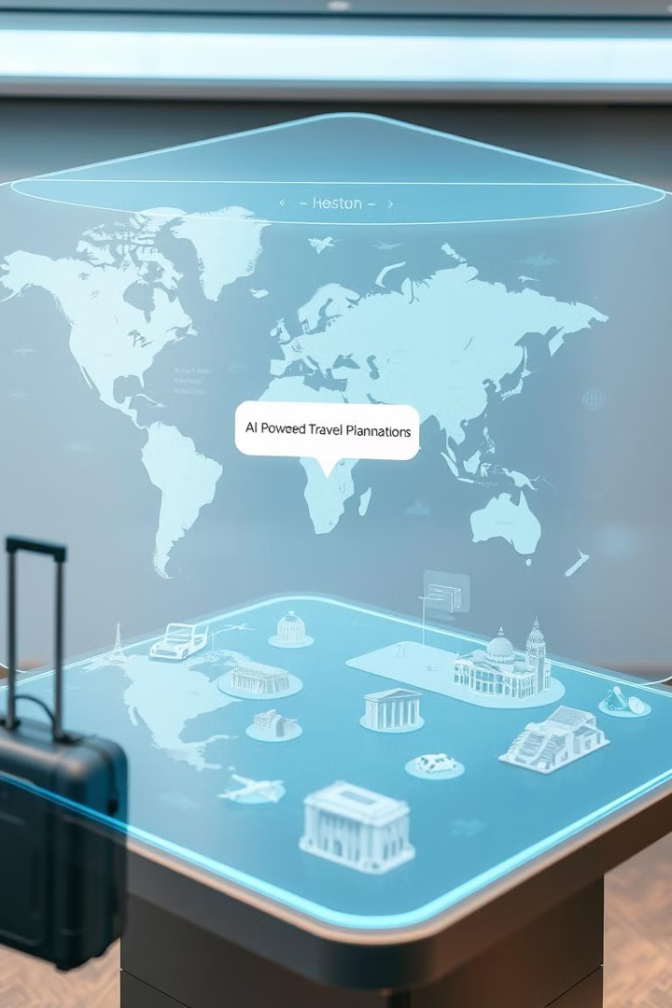
ExploreEase – AI-Powered Travel Planner
Transforming Travel Planning with AI.
ExploreEase is your smart companion for hassle-free travel planning. Our AI-powered platform creates personalized itineraries, optimizes budgets, and provides seamless booking assistance.

Slide 2


Your Smart Travel Companion
Introducing ExploreEase
ExploreEase revolutionizes travel planning with AI. We offer personalized itineraries and hassle-free booking assistance.
Your Smart Companion for Hassle-Free Travel Planning.

Slide 3




The Travel Planning Problem
Time-Consuming
Overwhelming Choices
Hours spent researching destinations and itineraries.
Too many options lead to decision paralysis.
Lack of Personalization
Generic recommendations don't fit unique preferences.
Did you know? Travelers spend an average of 20 hours planning a single trip.

Slide 4
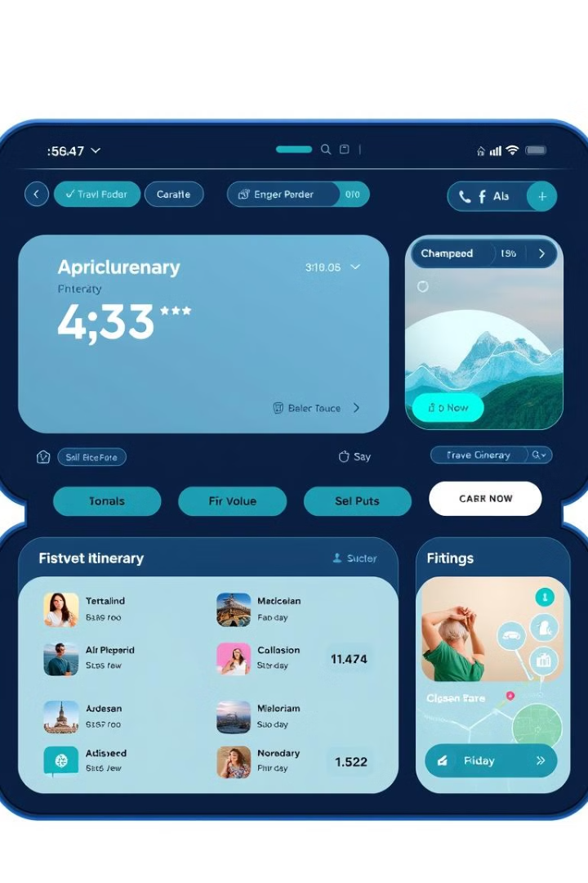
The ExploreEase Solution
AI-Powered Itinerary Planning
Intelligent trip generation based on your preferences.
Personalized Recommendations
Tailored suggestions for attractions, dining, and lodging.
Budget Optimization
Smart expense tracking to maximize travel funds.
ExploreEase solves these issues with AI-driven solutions.

Slide 5
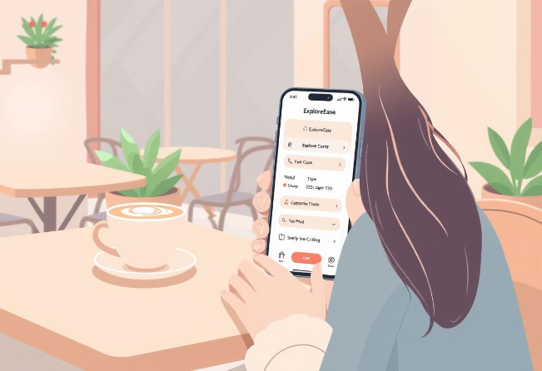




How ExploreEase Works
Input Preferences
AI Generates Itinerary
Tell us your travel style and interests.
Receive a custom-made travel plan.
Booking Recommendations
Seamless Travel
Seamlessly book flights, hotels, and activities.
Enjoy a stress-free travel experience.
A step-by-step user journey for hassle-free travel.

Slide 6





ExploreEase Key Features
Personalized Itineraries
Real-time Price Comparisons
Smart Budgeting
Integrated Booking
Travel Guides
Discover hidden gems with expert travel tips.

Slide 7



Under the Hood
1
AI/ML Models and APIs
2
Backend
3
Frontend
Our platform uses advanced AI/ML models, and secure APIs.

Slide 8
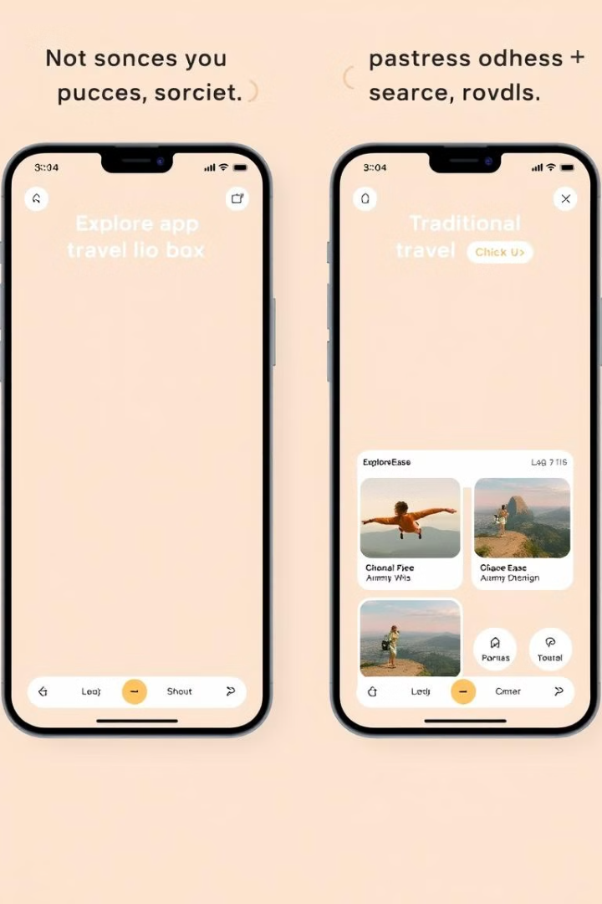
ExploreEase vs Traditional Apps
Itinerary Planning
AI-Powered
Manual
Personalization
Highly Personalized
Limited
Price Comparison
Real-Time
Delayed
Experience the unique AI-driven advantage.

Slide 9








Our Target Audience
Business Travelers
Backpackers
Efficient and reliable travel solutions.
Budget-conscious explorers looking for value.
Solo Travelers
Families
Independent adventurers seeking unique experiences.
Easy and stress-free vacation planning.

Slide 10

User Stories
1
“A game changer!”
2
“My go-to travel tool.”
3
“Simply amazing!”
Don't just take our word for it! Our users rave about ExploreEase. Hear their success stories and see how we've transformed their travels.

Slide 11

Future Enhancements
Multi-Language Support
Augmented Reality (AR)
Catering to a global audience with diverse languages.
Immersive travel experiences with AR technology.
AI-Powered Real-Time Assistance
Intelligent support throughout your journey.

Slide 12
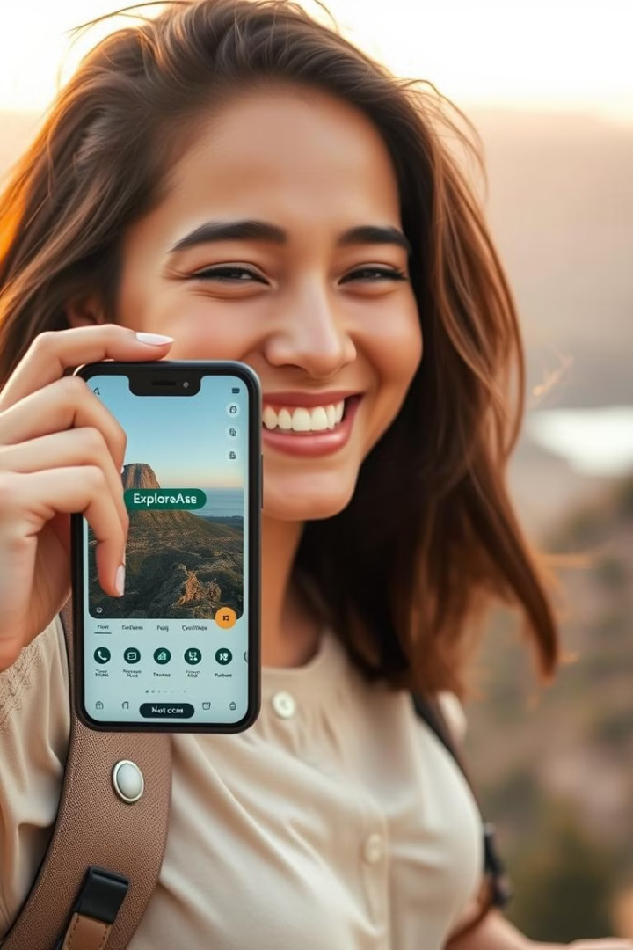
Explore Smarter with ExploreEase!
Recap: ExploreEase transforms travel planning with AI. Key benefits: Personalized itineraries and budget optimization. Let’s Explore Smarter with ExploreEase!

